Slide 1
Vertual reality
Team 5

Slide 2
Introduction

Slide 3
Introduction
Our designing conception is making a virtual reality system , as long as we put on “BIG DANNY” , we can enter into the virtual world , experiencing a whole new world .

Slide 4
Introduction
In “BIG DANNY” , we can become anyone we like, do anything we want , go to anywhere we can’t arrive .

Slide 7
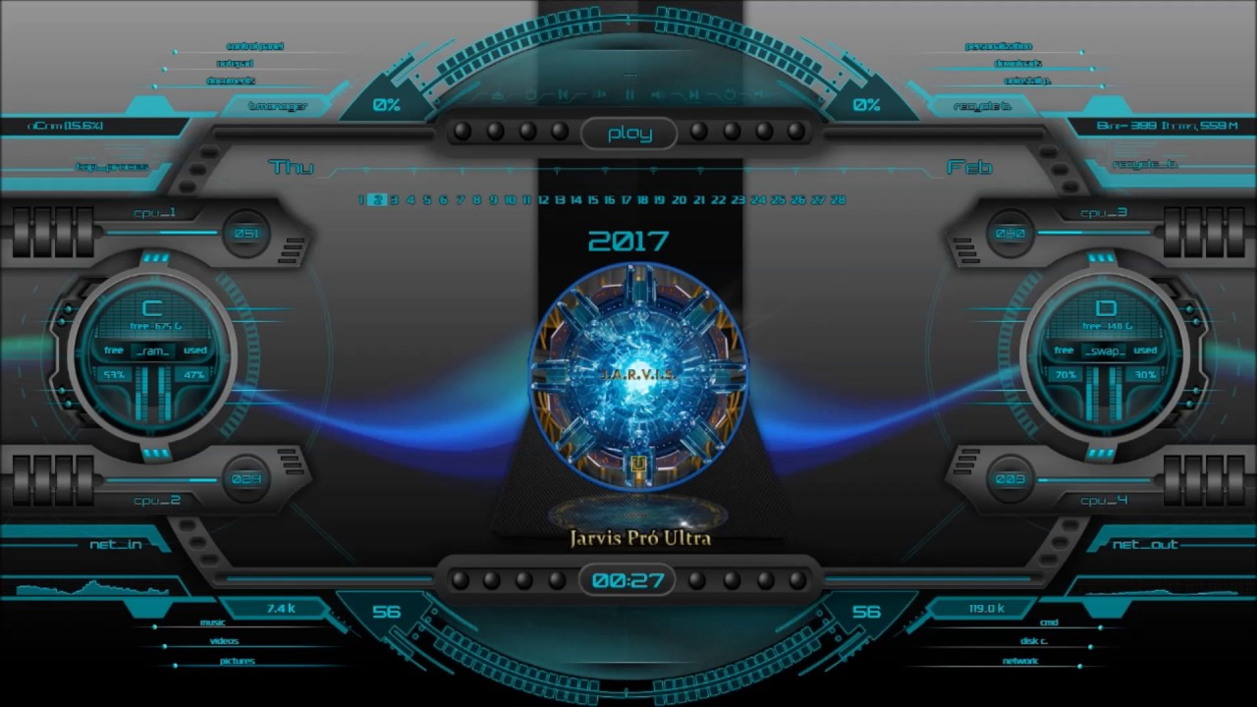
HardWare And Software

Slide 8
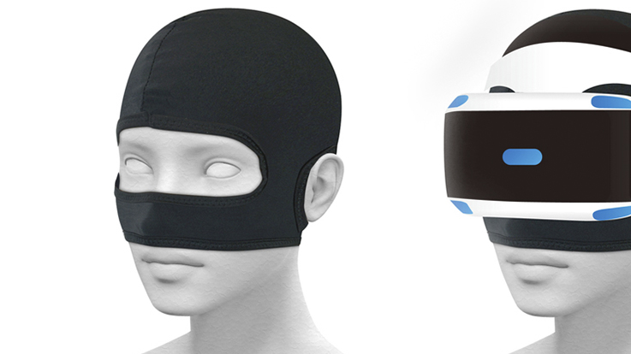
HardWARe
Wearing device
Basic device of VR

Slide 9
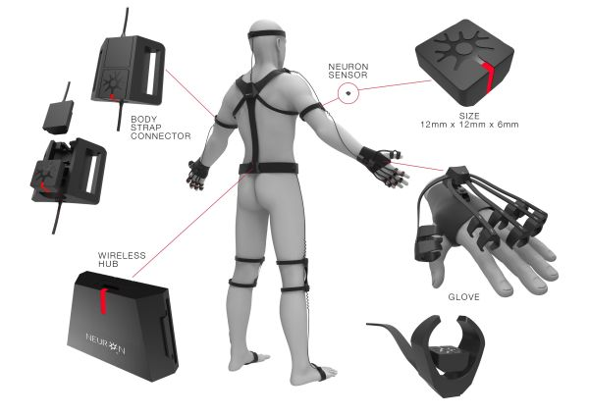
HaRDWARE
Body sensor
Use body sensor to detect the body movement.

Slide 10
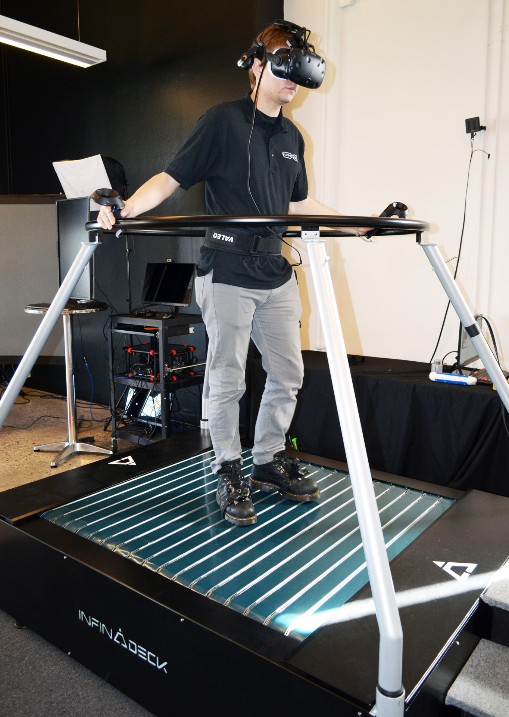
HarDWARE
Treadmill
Running on the treadmill make you run on the fixed area.

Slide 11
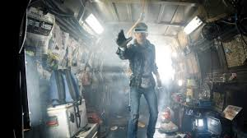
SOFTWARE
Real World
Virtual World

Slide 12
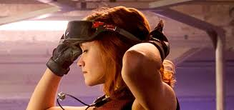
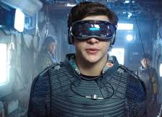
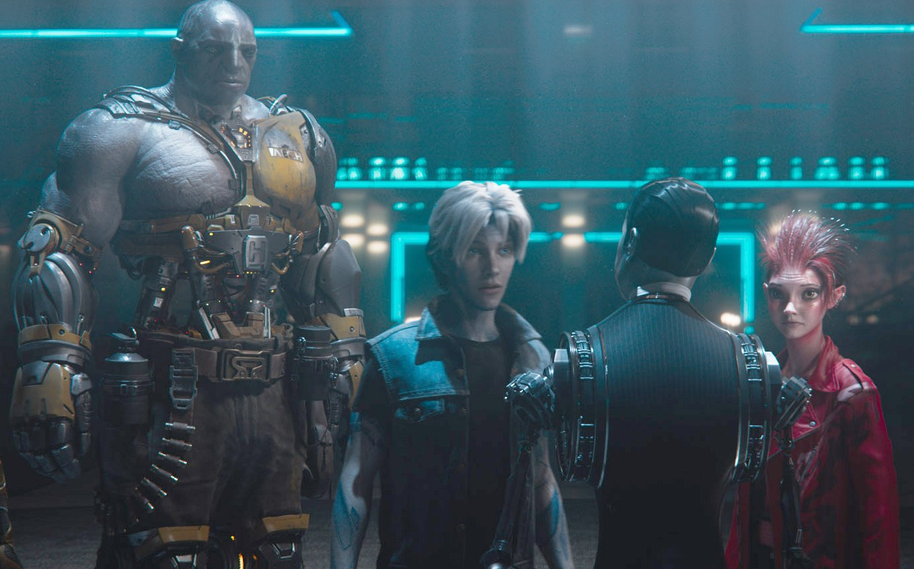
SOFTWARE
Virtual World
You can become who you want to be and make friends in the virtual world

Slide 13
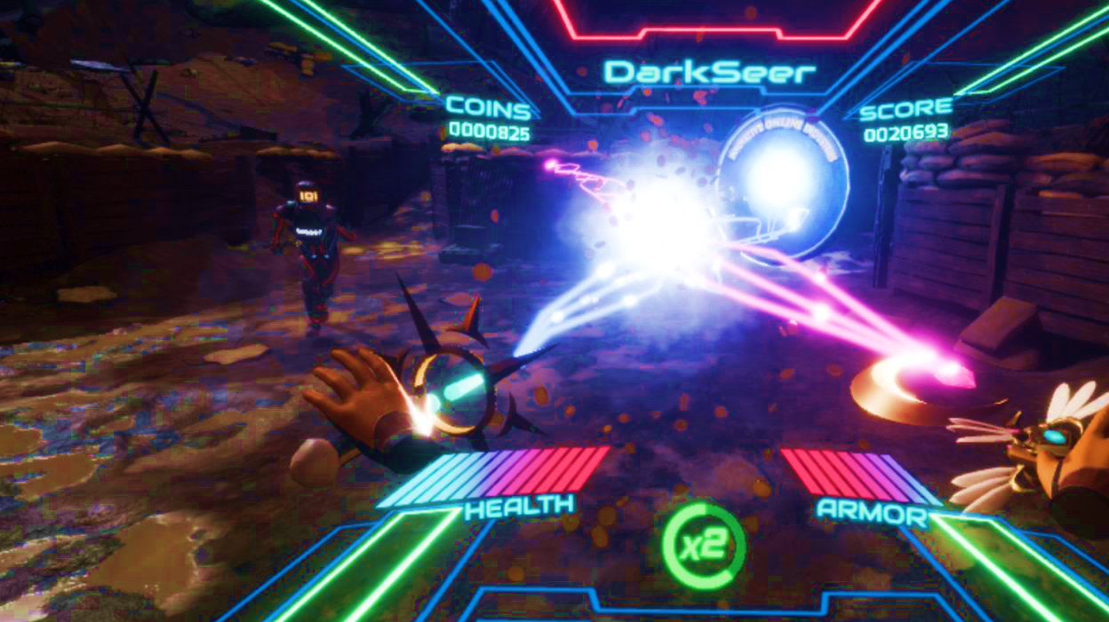
SOFTWARE
Shooting Game
Playing shooing game in VR make you feel as if you are in a real survival game.

Slide 14
Good or bad?

Slide 15
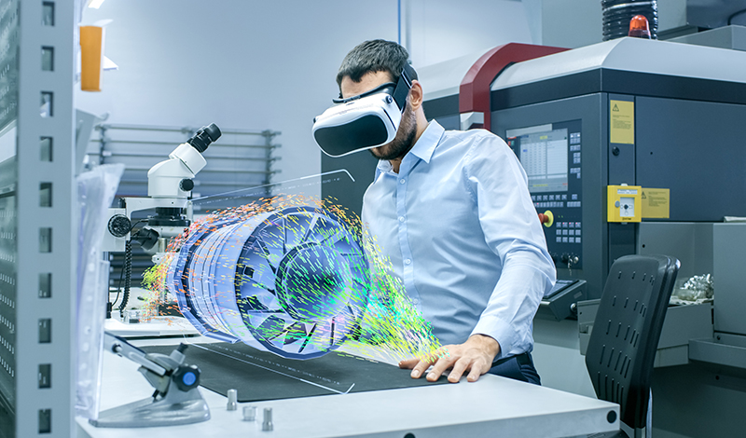
Good
Entertain for a real world
Can simulate the situation that difficult to happen
It can support to scientist or any organization

Slide 16
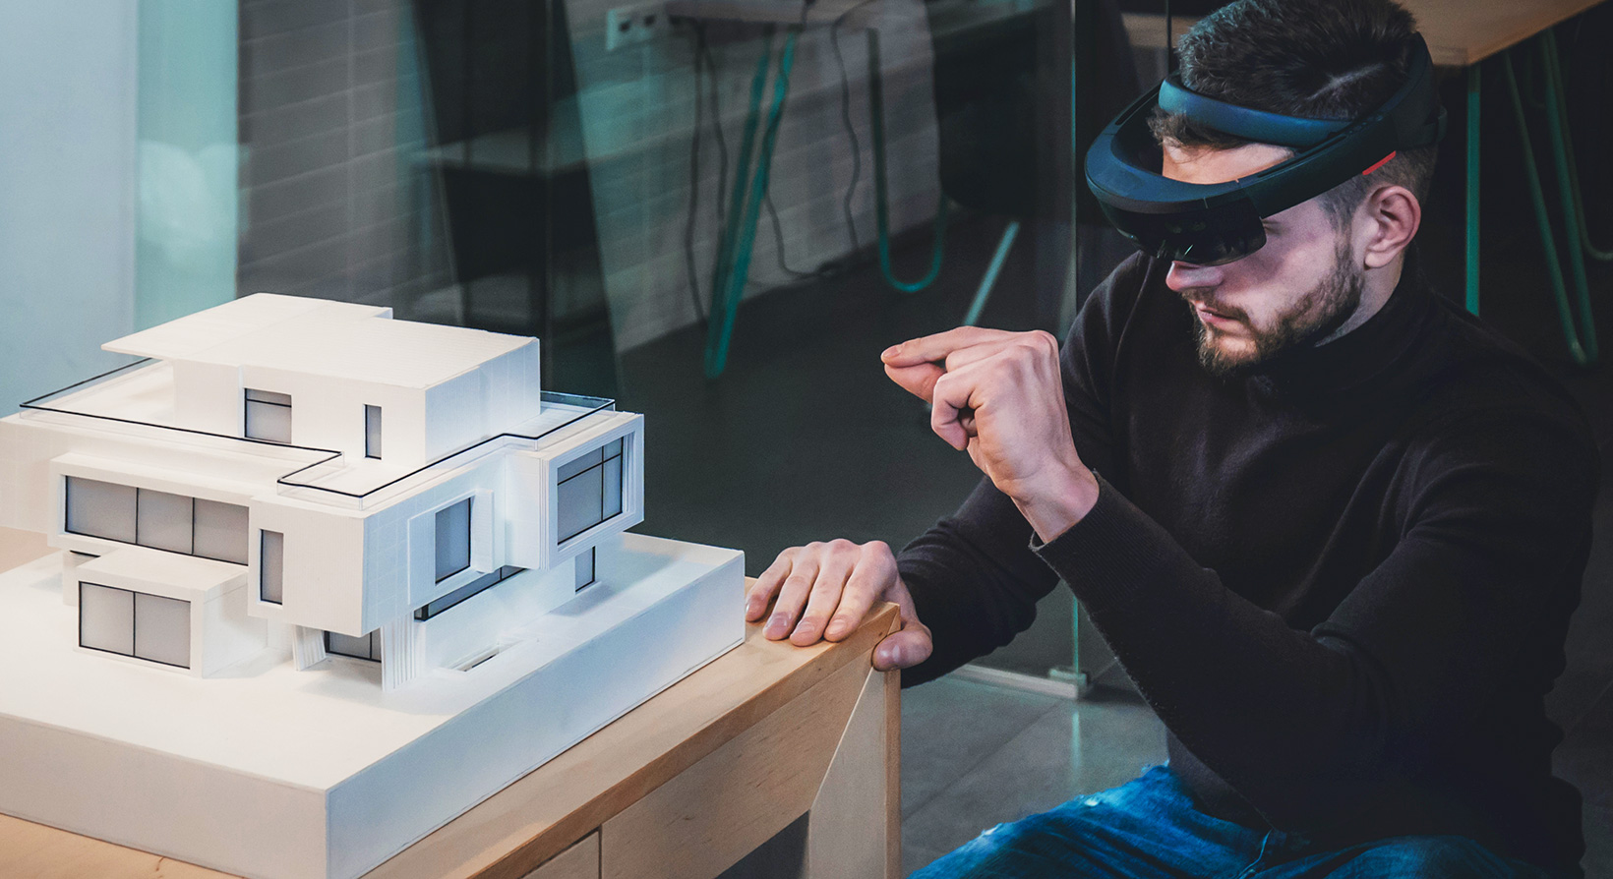

Slide 17
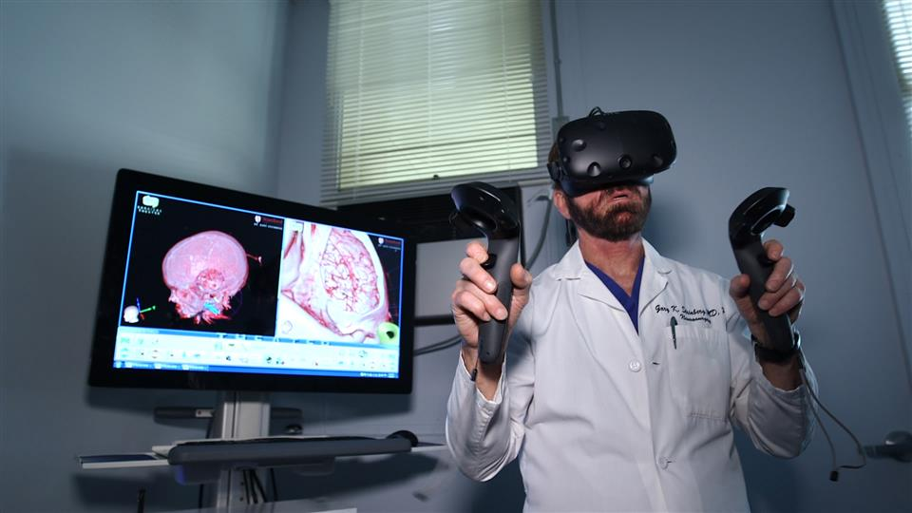

Slide 18
Bad
virtual reality headsets are really expensive.
It can make you sick by causing nausea, headache, dizziness and a lot more.
It damages your eyes.
It can cause neurological damage which is termed as “Simulator sickness” or “Virtual reality sickness”

Slide 19
